Slide 1


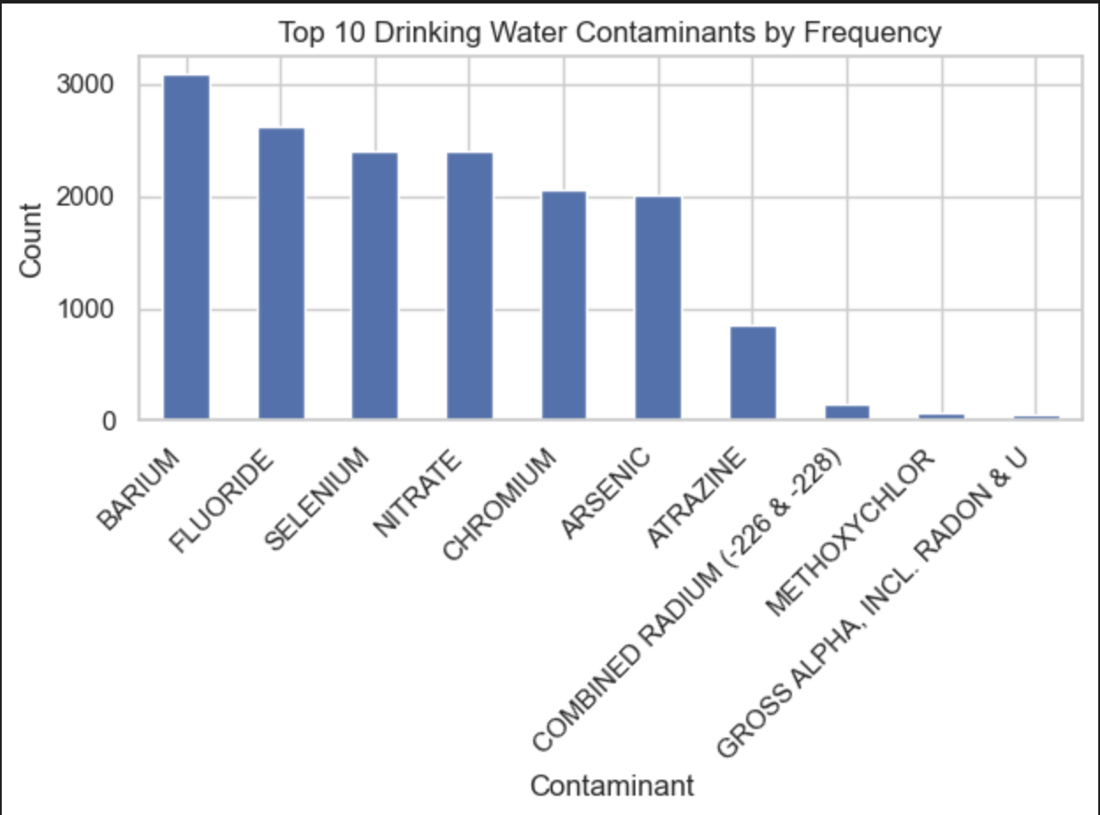
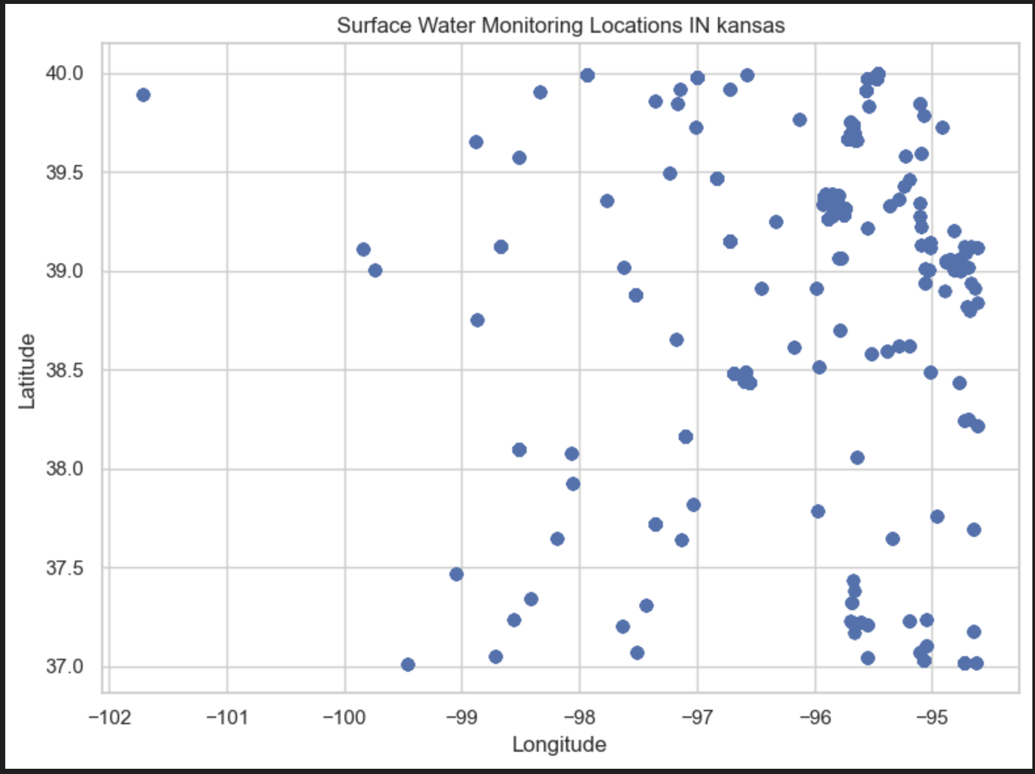
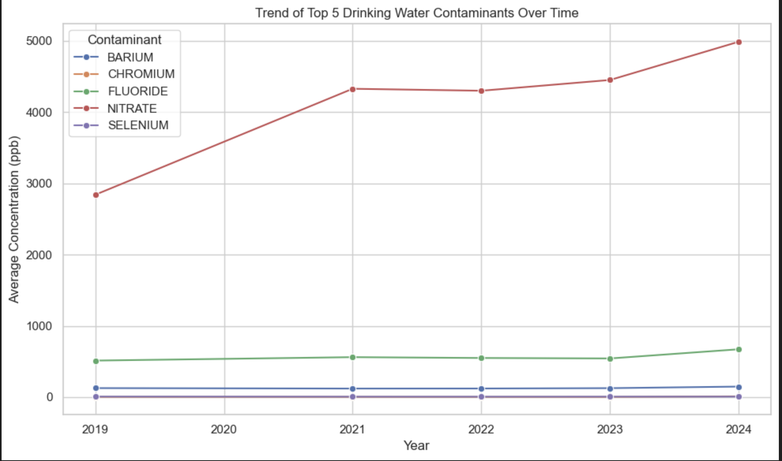
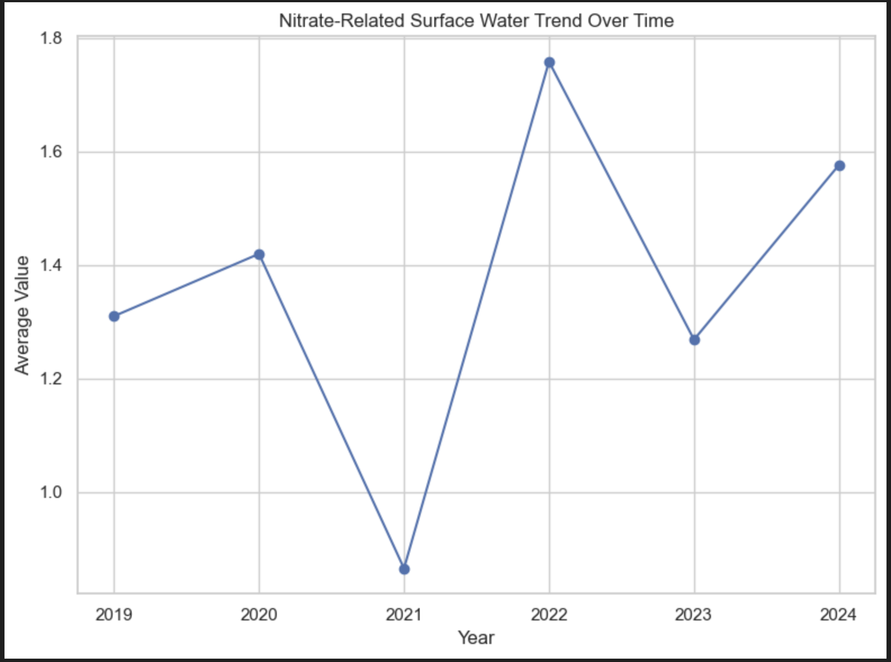
Surface Water and Drinking Water Contaminants in Kansas
Kavya Sri Modepu, Bindu Nagasai Nadella - Wichita State University
Introduction
Results
Surface Water Analysis
Surface water monitoring locations are distributed across Kansas, covering approximately 164 unique monitoring sites.
This spatial distribution allows for geographic exploration of water quality patterns.
Nitrate-related surface water measurements show clear variation across locations, with no single dominant hotspot.
Temporal analysis shows that nitrate-related values fluctuate over time:
This project analyzes water quality conditions in Kansas to understand how contamination in surface water may affect community drinking water systems. The project was developed in collaboration with the Kansas Data Science Consortium (KDSC) and community partner ARISE.
Water quality is a critical public health concern, as contaminants in drinking water can directly impact human health and environmental safety. Understanding contamination patterns helps support better monitoring and decision-making.
Goal: Identify important contaminants in drinking water and examine whether similar patterns appear in surface water data.
Challenge: Due to missing geographic identifiers in the drinking water dataset, a direct linkage between surface water and drinking water systems was not possible.
Instead, the project focuses on two components:
• Statistical analysis of drinking water contaminants
• Spatial and temporal analysis of surface water measurements
This approach provides insight into contamination behavior even without a direct dataset linkage.
Drinking Water Analysis
Barium, Fluoride, Selenium, Nitrate, and Chromium are the most frequently reported contaminants.
Nitrate stands out clearly, with significantly higher concentration levels than all other contaminants.
Nitrate increases overall from ~2800 ppb (2019) to ~5000 ppb (2024), but the trend is not linear.
2019–2020: +1500 ppb 2020–2021: −700 ppb
2021–2022: +800 ppb
2022–2023: +100 ppb
2023–2024: +500 ppb
Other contaminants (Barium, Chromium, Fluoride, Selenium) remain relatively stable with minor variations.
Nitrate is the only contaminant showing both high concentration and an upward trend, making it the most significant contaminant in this analysis.
Lowest observed around 2021 (~0.86, average concentration level)
Peak observed around 2022 (~1.75, average concentration level)
Moderate levels in other years
Discussion
Contaminant behavior varies across substances, with nitrate emerging as the most significant due to its high levels and upward trend.
Surface water analysis shows nitrate is distributed across multiple locations and fluctuates over time, indicating no single dominant hotspot.
A key limitation is the lack of geographic identifiers in the drinking water dataset, preventing direct linkage with surface water data.
These findings suggest that surface water contamination patterns may influence drinking water quality, even though a direct connection could not be established.
High nitrate levels may be influenced by agricultural runoff or environmental factors, highlighting the need for closer monitoring.
The difference between stable contaminants and nitrate shows that not all contaminants behave the same, emphasizing the importance of contaminant-specific analysis.
Data Source & Preparation
Two datasets were used:
Drinking Water Dataset (CCR)
Municipal water system reports
Cleaned and standardized to ppb
Non-numeric values (e.g., “<0.5”, “ND”) converted
Surface Water Dataset (WQP)
Water Quality Portal data
Includes latitude and longitude
Cleaned by removing missing values and converting numeric fields
Final datasets:
Drinking water: ~16,000 observations
Surface water: ~17,000 observations across ~164 locations
Exceedance Analysis
Exceedance analysis shows that Atrazine has the highest exceedance rate (~6%), followed by Nitrate (~3–4%).
Some contaminants initially appeared to have very high exceedance rates, but these were based on very small sample sizes.
After filtering for contaminants with sufficient observations, the results show that exceedance is not solely driven by high concentration levels, but also by regulatory thresholds and variability.

